Slide 1












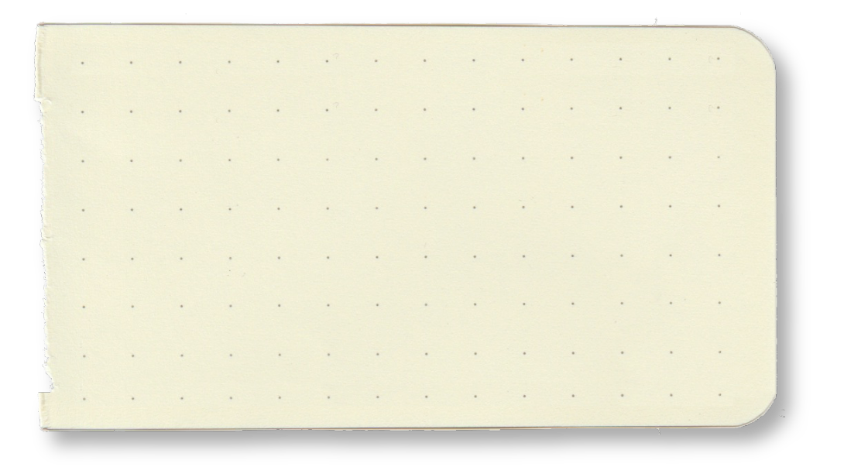
flower shop

Slide 2
Objectives

Slide 3







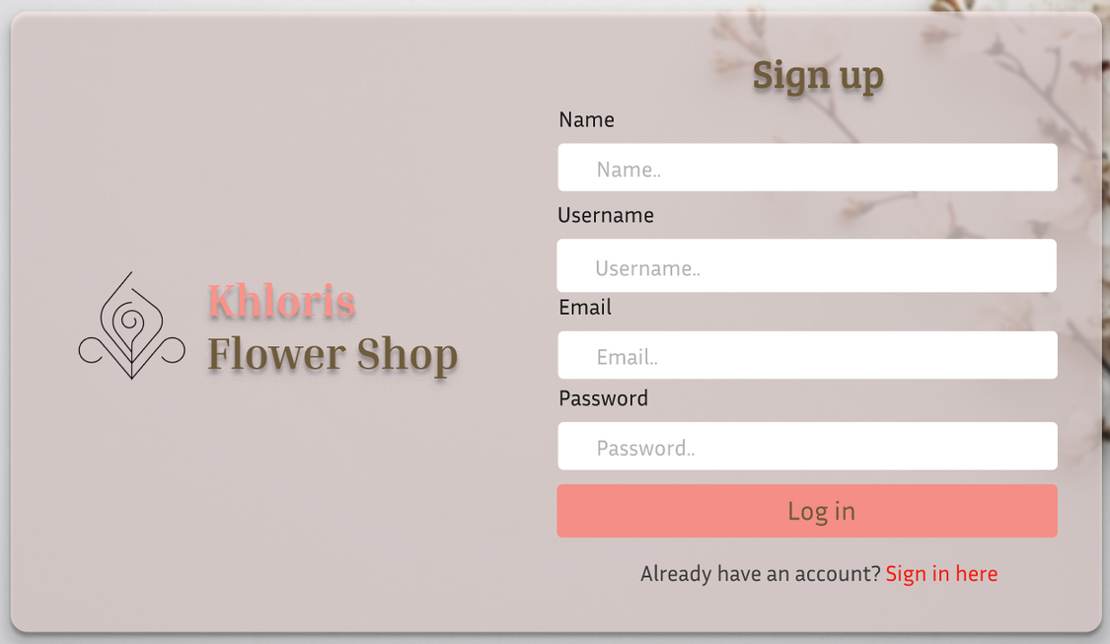
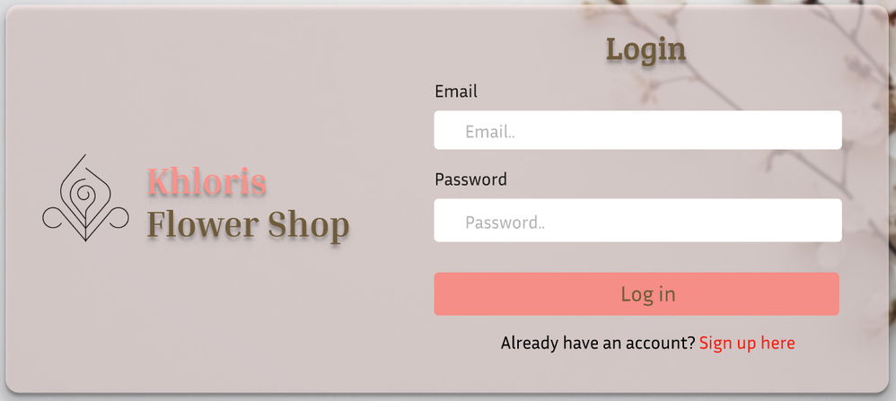
USER
Sign up / Sign in

Slide 4

USER
Can browse without login

Slide 5
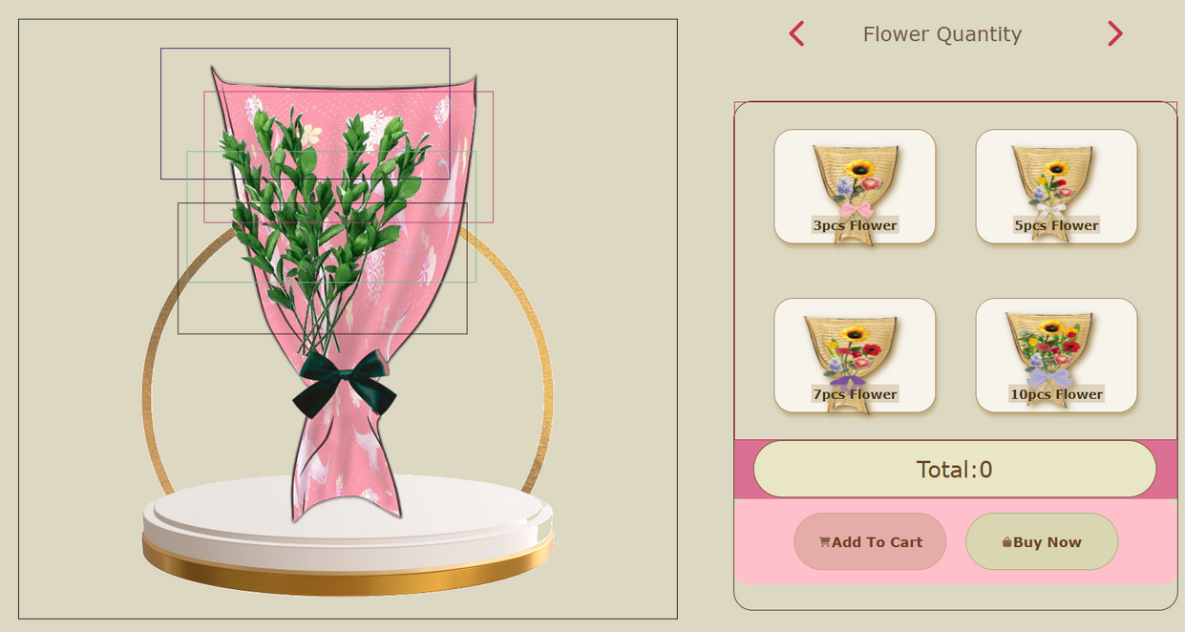

USER
Virtual bouquet customization

Slide 6

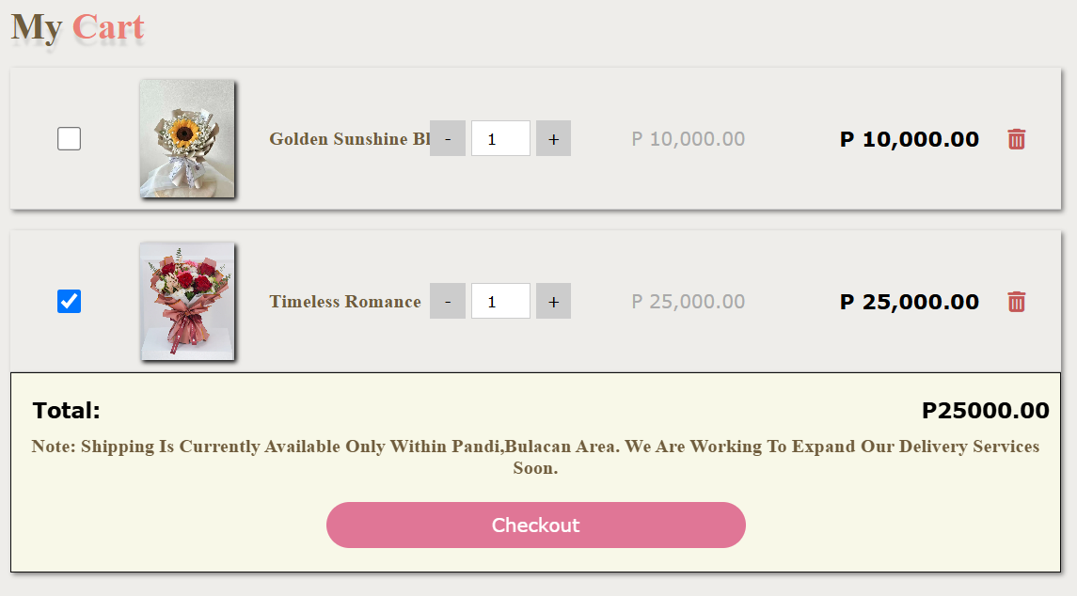
USER
Add to cart (restricted by login)

Slide 7
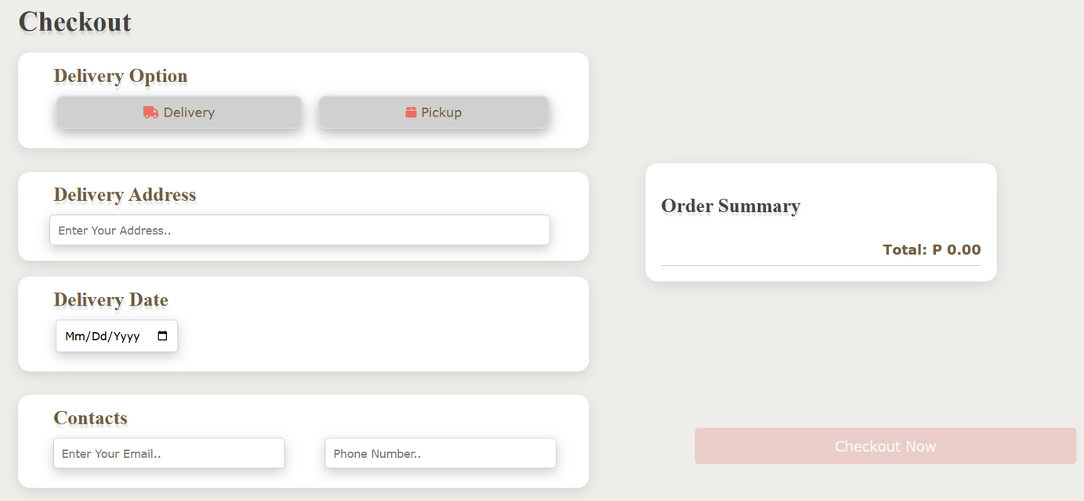

USER
Checkout

Slide 8

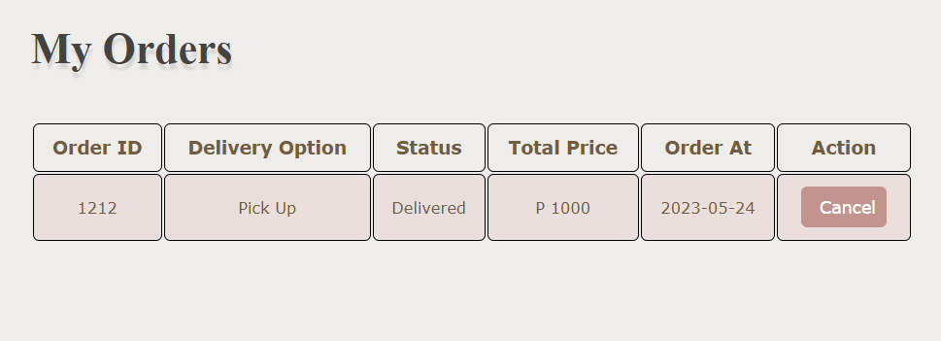
USER
View order information

Slide 9
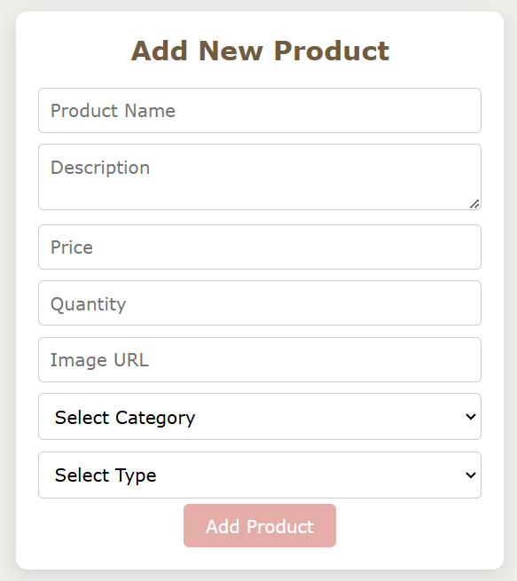
ADMIN
Add product

Slide 10
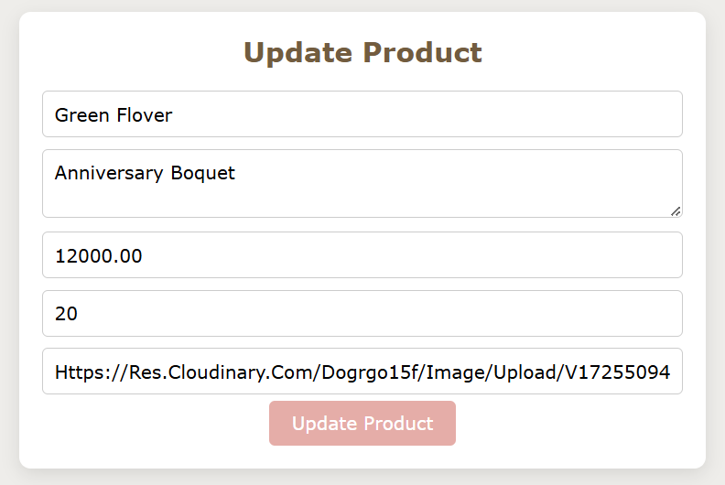
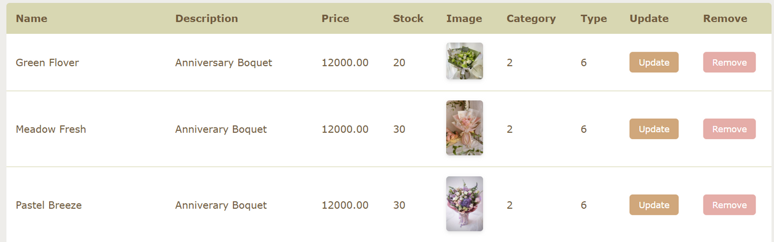
ADMIN
Edit product information

Slide 11
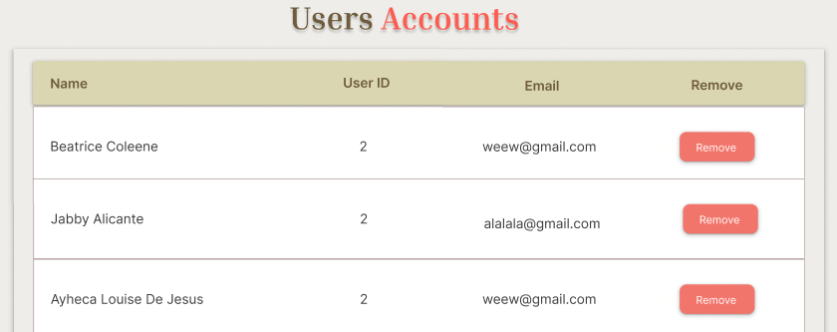
ADMIN
Monitor user account

Slide 12
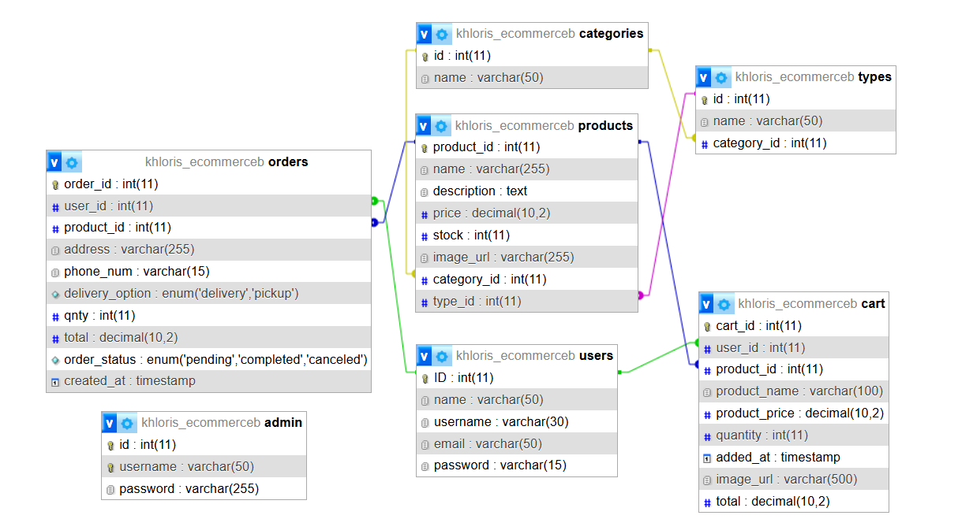
Database

Slide 13



Technologies used
HTML
CSS

Slide 14

Technologies used

Slide 15
Technologies used

Slide 16

Technologies used
JAVASCRIPT

Slide 17











